Slide 1
Determining the Presence of Viruses Using Multiplex PCR
Ellie Anderson

Slide 2




Notes:
Intro: I’ve had a lot of tests over the last two years, many covid tests, many strep tests, it’s a pain. And they have to do a different swab for different tests. What if they could do 1 test and identify any of 29 viruses you have? It would be super nice.

Slide 3

PCR
PCR - Amplifies target DNA strands
Notes:
Basics of PCR – have a target DNA strand that you want to amplify to learn more about it
Can also use it to detect DNA strands

Slide 4
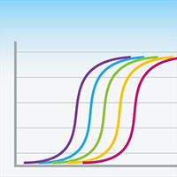
Multiplex PCR
- Uses real-time PCR and fluorescence to identify which targets are present
- Measures the amount of target DNA present after each cycle
- Can detect multiple targets at a time
Notes:
Real-time PCR monitors how many targets are present per cycle using fluorescence
Using fluorescence, we can detect multiple targets at once. Explain how this works

Slide 5
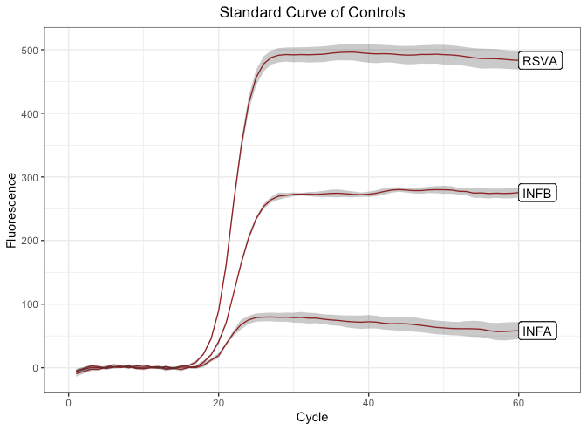
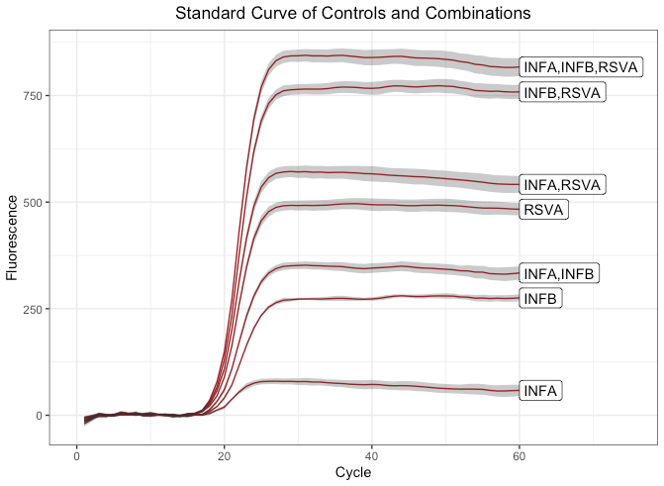
Standard Curves
Notes:
Standard error is the sd of the sample data – explain why we use se instead of sd
Got the standard curves of each control (InfA, infB, rsvA) from data
The controls are additive to create the combos

Slide 6
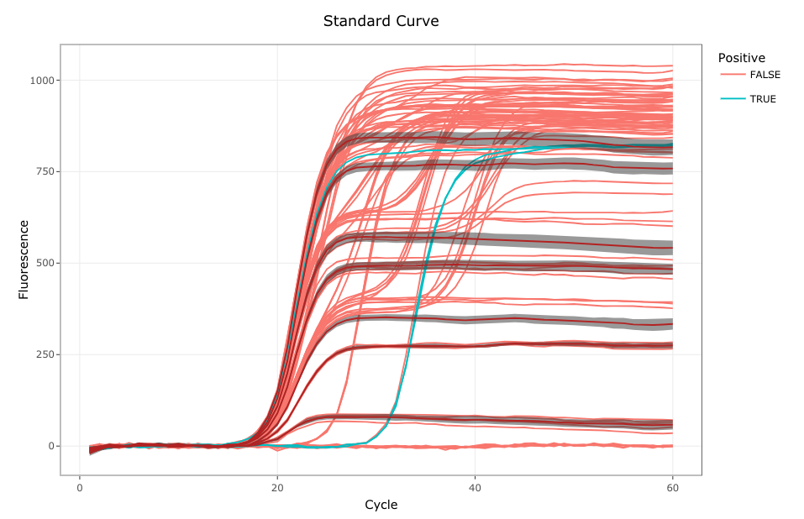

Statistics test
Kruskal-Wallis Test
Wilcoxon Test
$$\hat{x} −\overline{x}<2∗SE$$
Notes:
Tried Wilcoxon Test, Kruskal-Wallis. The results I was getting weren’t in the se we wanted so made my own test
Used last 10 points of the data, if ____% of them were within the SE of the standard curve, we would say it was the same - the points can change

Slide 7
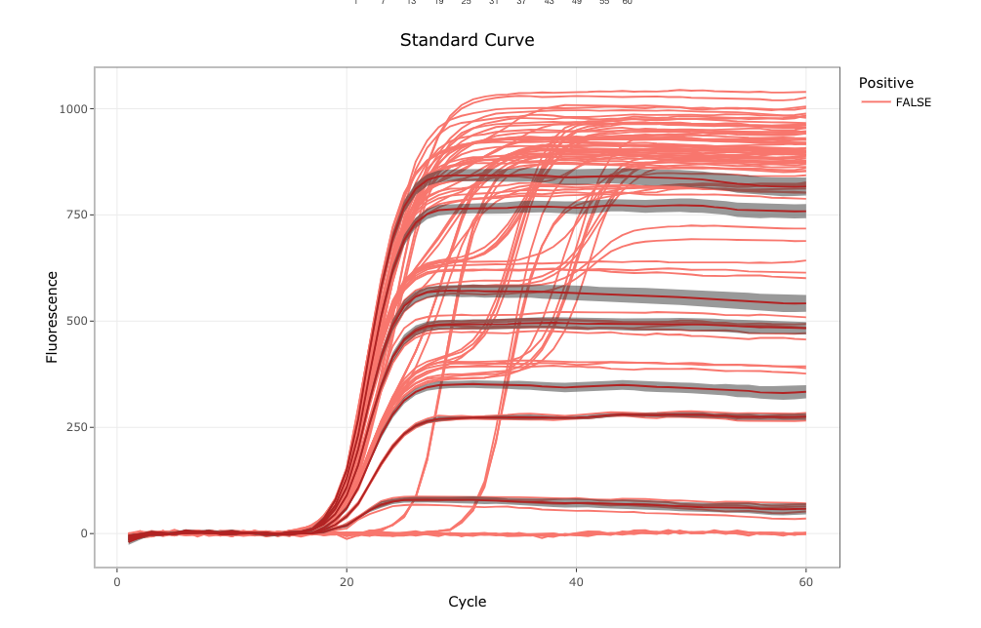
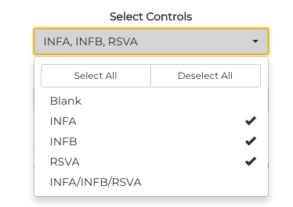
Shiny app
Notes:
The data that I used already had all the viruses identified in the
Select your controls to create standard curves

Slide 8
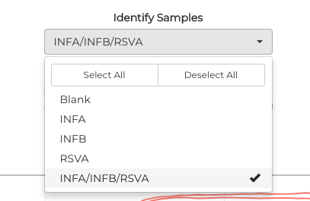
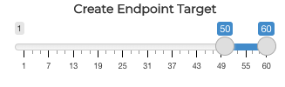
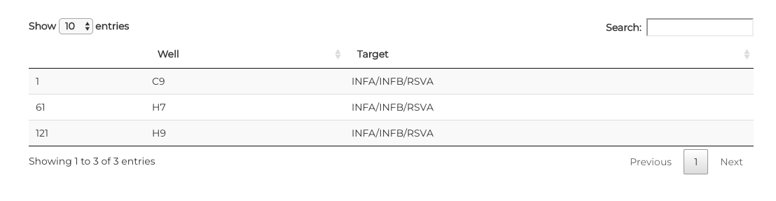
Shiny app
Notes:
Select sample wells and the endpoint targets.
This outputs a graph that shows the specific wells that test positive with any virus

Slide 9
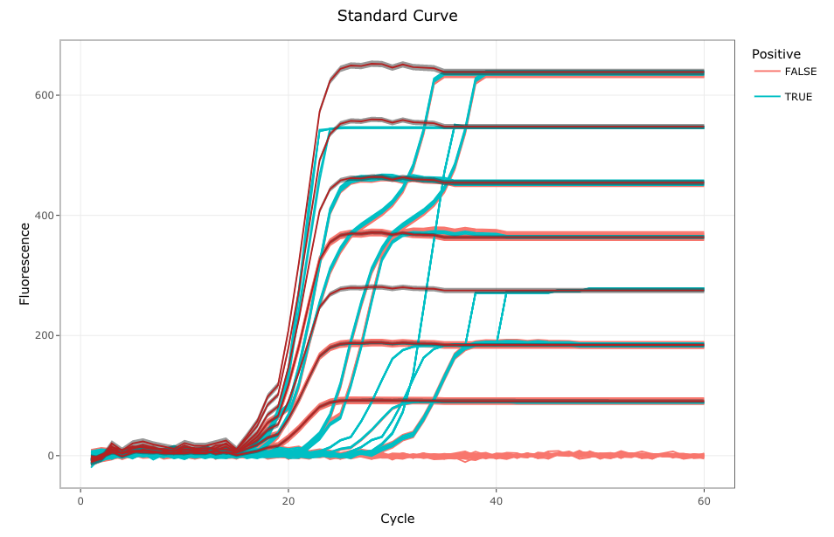
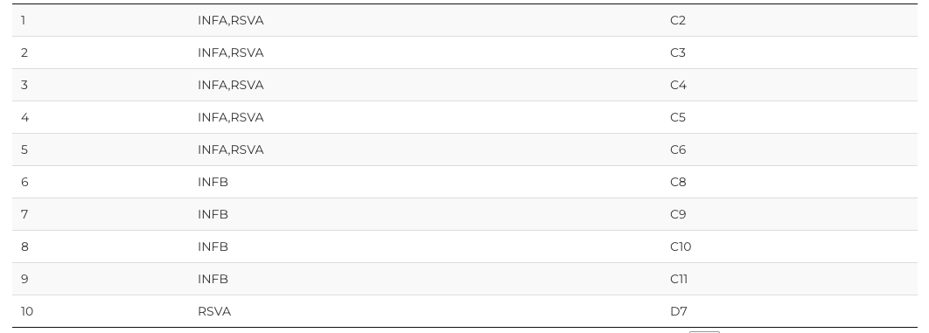

Slide 10
Resources
https://www.cedars-sinai.org/blog/doctor-visit-during-covid-19.html
https://fortune.com/2019/04/27/branding-plus-sign/
https://wellcareurgentcare.com/services/medical-testing/strep-test/
https://www.covidtests.gov/
https://www.takarabio.com/products/real-time-pcr

